Slide 1


Paper ID: 300
Paper Title: Pneumonia Detection Using Vision Transformers
Authors: Geetika Munjal, Suyash Thakur, Dhruv Sunil, G V Rishvanth
Notes:
"Pneumonia: 'The world is underestimating the threat of pneumonia, a disease that claims more lives than HIV, malaria, and tuberculosis combined.' – Dr. Tedros Adhanom, Director-General of the World Health Organization.“
Good afternoon, esteemed researchers, and attendees. I Dhruv Sunil will be presenting our paper titled Pneumonia Detection Using Vision Transformers.

Slide 2
INTRODUCTION
Pneumonia: A leading global health concern.
Pneumonia: A leading global health concern.
Linked to factors like malnutrition, air pollution, and inadequate healthcare.
AI in Healthcare:
Enables faster and more accurate diagnostics.
Study Focus:
Comparing Vision Transformers (ViTs) with CNNs for pneumonia detection using chest X-rays.
Notes:
According to UNICEF in 2021, pneumonia is the leading cause of death among children. Almost all of these deaths are preventable, but this still ends up taking the lives of more than 700,000 children annually."‘Pneumonia remains a leading cause of death worldwide, yet it is preventable and treatable.’ – Dr. Anthony Fauci, Director of the National Institute of Allergy and Infectious Diseases."It is estimated that millions of deaths occur annually due to late diagnosis.Late diagnosis of pneumonia often leads to severe complications and higher mortality rates. According to a study by John Hopkins medicines in 2019, researchers found that diagnostic errors were the most catastrophic and costly medicinal mistakes. The big 3 diagnostic errors , leading to death or serious permanent disability were associated with misdiagnosed cancers (37.8%), vascular events(22.8%) and infections (13.5%).

Slide 3
Objectives
Propose an AI-based solution for pneumonia detection.
Leverage Vision Transformers for feature extraction and classification.
Validate model using accuracy, precision, and recall.
Notes:
AI-based solutions can counter this by providing earlier and accurate detection through advanced image analysis and predictive models. This technology enables timely intervention, reducing delays in treatment and significantly improving patient survival rates and outcomes.We have utilized Vision Transformers (ViTs) and traditional Convolutional Neural Networks (CNNs) for analyzing chest X-ray images. Also, comparing different CNN models by evaluating the classification metrics.

Slide 4
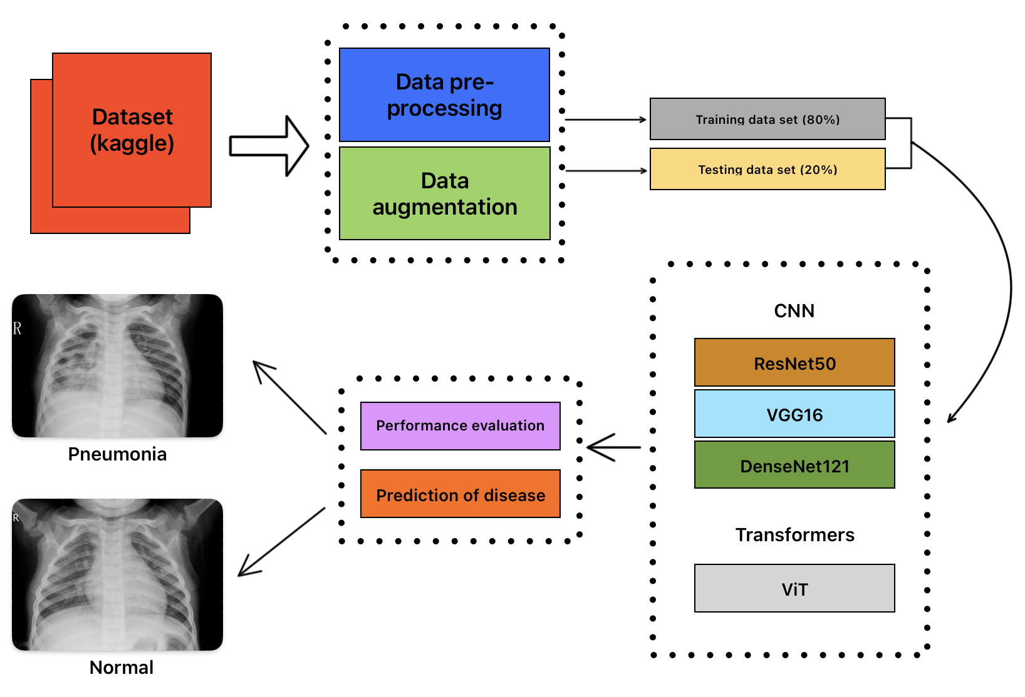
Methodology
Dataset:
Public Kaggle dataset: 5,863 chest X-ray images
Split: 80% Training, 20% Testing.
Classes: Pneumonia (74%) and Normal (26%).
Class Weighting: Normal (1.94), Pneumonia (0.67).
Models:
CNNs: VGG16, ResNet50, DenseNet121.
ViTs: Pre-trained on ImageNet-21k, fine-tuned for pneumonia detection.
Workflow:
Notes:
ImageNet-21k, used in ViT model, contains over 21,000 categories.
VGG16 uses stacked 3x3 convolutions, increasing depth and allowing the model to learn complex hierarchical features. While effective, VGG16 is memory-intensive and suffers from vanishing gradients.
ResNet50 introduces residual connections, which mitigate the vanishing gradient problem, allowing deeper. However, it can still become computationally heavy at scale.
DenseNet121 employs dense connections, where each layer receives input from all preceding layers. While more compact, DenseNet can experience memory bottlenecks during training.

Slide 5
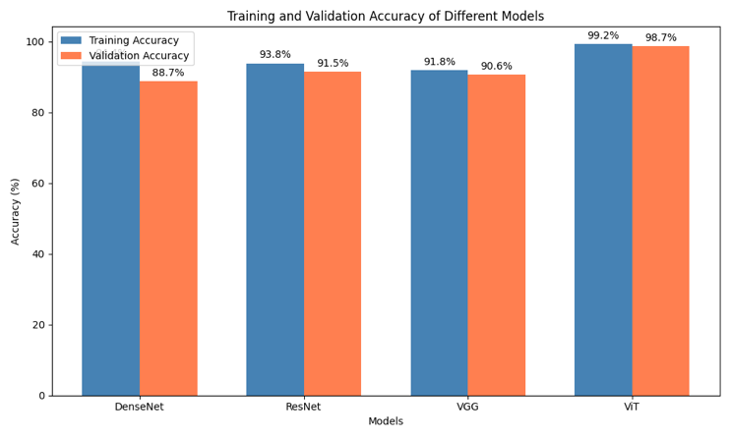
Results and Discussion
Key Metrics:
ViT achieved Training Accuracy: 99.28%, Testing Accuracy: 98.15%.
Outperformed CNNs in precision, recall, and F1-score.
Visuals:
Training and testing Accuracy Chart (ViT: Better generalization).
Comparison:
Notes:
However, despite their effectiveness, these models still struggle with modeling global dependencies in images. This is where Vision Transformers (ViTs) shine. Transformers, originally designed for NLP tasks, use self-attention mechanisms to focus on important image patches. This allows them to capture long-range dependencies more effectively than CNNs. ViTs can adapt to imbalances in data and avoid biases inherent in traditional CNNs.
In our approach, we use transfer learning with a pre-trained ViT model from ImageNet-21k, fine-tuned for pneumonia detection. This accelerates training, particularly when working with limited and imbalanced datasets.

Slide 6
Future Research Directions
Data Augmentation: Use advanced techniques tailored for medical imaging.
Explainability: Enhance ViT interpretability for clinical trust.
Hybrid Models: Combine CNNs and ViTs for local and global feature extraction.
Real-Time Implementation: Optimize ViTs for resource-constrained environments.
Notes:
Data Augmentation:
Medical datasets are often imbalanced, with pneumonia cases dominating. This can lead to biased model predictions.
To address this, we can use techniques like elastic transformations, GANs for synthetic data generation, and SMOTE for oversampling underrepresented classes.
Explainability of ViTs:
ViTs are often considered ‘black-box’ models, making them difficult for clinicians to trust.
We can develop attention visualization techniques to highlight which areas of the X-ray the model is focusing on, improving interpretability and clinician confidence.
Hybrid Models (CNN + ViT):
CNNs are excellent for extracting local features, while ViTs capture global context. Combining both models can enhance accuracy by leveraging the strengths of each.
Real-Time Implementation:
ViTs are computationally intensive. To enable real-time use in low-resource settings, we can optimize them through pruning, quantization, and use efficient models like MobileViT."

Slide 7
Conclusion
Findings:
ViTs demonstrate high accuracy, precision, and recall.
Effective for real-world medical imaging applications.
Future Work:
Address data imbalance and computational efficiency.
Explore hybrid and transfer learning strategies.
Notes:
Summary of Findings:
ViTs showed 99.28% training accuracy and 98.15% testing accuracy for pneumonia detection, outperforming CNNs in key metrics like precision, recall, and F1-score.
Real-World Impact:
ViTs can assist radiologists by automating preliminary screenings, reducing diagnostic time and errors, and are scalable for use in hospitals, clinics, and mobile units.
Limitations:
The high computational cost of ViTs and their lack of clear explanations are challenges, particularly in low-resource settings.
Vision for the Future:
With ongoing advancements, ViTs could become integral to clinical workflows, improving diagnostic accuracy and efficiency. This research sets the stage for more innovations, bridging AI and real-world healthcare applications.

Slide 8
References
[1] Kermany, Daniel; Zhang, Kang; Goldbaum, Michael (2018), "Labeled Optical Coherence Tomography (OCT) and Chest X- Ray Images for Classification", Mendeley Data, v2
[2] Tyagi, K., Pathak, G., Nijhawan, R., & Mittal, A. (2021, December). Detecting pneumonia using vision transformer and comparing with other techniques. In 2021 5th international conference on electronics, communication and aerospace technology (ICECA) (pp. 12-16).
[3] Singh, S., Kumar, M., Kumar, A., Verma, B. K., Abhishek, K., & Selvarajan, S. (2024). Efficient pneumonia detection using Vision Transformers on chest X-rays. Scientific Reports, 14(1), 2487.
[4] Wang, T., Nie, Z., Wang, R., Xu, Q., Huang, H., Xu, H., ... & Liu, X. J. (2023). PneuNet: deep learning for COVID-19 pneumonia diagnosis on chest X-ray image analysis using Vision Transformer. Medical & Biological Engineering & Computing, 61(6), 1395-1408.
[5] Raghaw, C. S., Bhore, P. S., Rehman, M. Z. U., & Kumar, N. (2024). An Explainable Contrastive-based Dilated Convolutional Network with Transformer for pediatric pneumonia detection. Applied Soft Computing, 112258.
[6] Mabrouk, A., Diaz Redondo, R. P., Dahou, A., Abd Elaziz, M., & Kayed, M. (2022). Pneumonia detection on chest X-ray images using ensemble of deep convolutional neural networks. Applied Sciences, 12(13), 6448.

Slide 9

THANK YOU!

